Slide 1
Knuckle Input
Robin Schweigert, Simon Hagenmayer, Jan Leusmann
Fachpraktikum Interaktive Systeme: Machine Learning and Computer Vision for HCI | Stuttgart | 07.11.2018

Slide 2
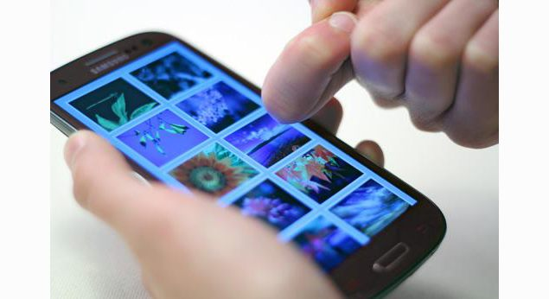
Introduction
Another input method for smartphones
“Right-click”
Until now, microphones as differentiation tool
Notes:
Use Knuckle as another input method for smartphones
Having a second input method is great e.g. can be used as “right-click”
Until now mircophones have been used to differentiate

Slide 3
Related Work: TapSense: Enhancing finger interaction on touch surfaces
Identify part of finger used for input
Four different finger inputs
Sound-based
Support Vector Machine:
86% accuracy
98% accuracy (pairs)

Slide 4
Related Work: Augmenting Touch Interaction Through Acoustic Sensing
Distinguishing between input methods is not possible when only based on touch image
Therefore sound is used in addition
Different inputs result in different sounds
Capture both peaks and frequencies
Problems
Noisy environments: bad inputs
No data about accuracy

Slide 5
Related Work: Nail+
Different levels of applied finger-force can be detected
3x3 grid of strain sensors, worn on the fingernail
When force is applied, electrical resistance changes
Connected with arduino
Prototype reaches 84,67% accuracy
Needs to be calibrated before each use
Study with 10 gestures (swiping, force-applied touch)
Tapping easier distinguishable than swiping
Notes:
Idea for paper: detect force

Slide 6
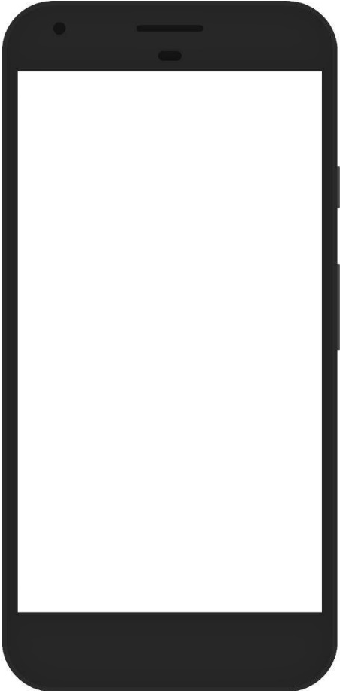
Project planning: Android-App
Input method
Finger
Knuckle
Tap Type
Tap
Double-Tap
Long-Press
Randomized Targets
Collected data
UserID
Timestamp
TargetID
Condition
Position
Capacitive image
Input method
Tap type
Notes:
Different tap types to gather different kinds of capazitive images
Randomized targets to users dont get bored

Slide 7
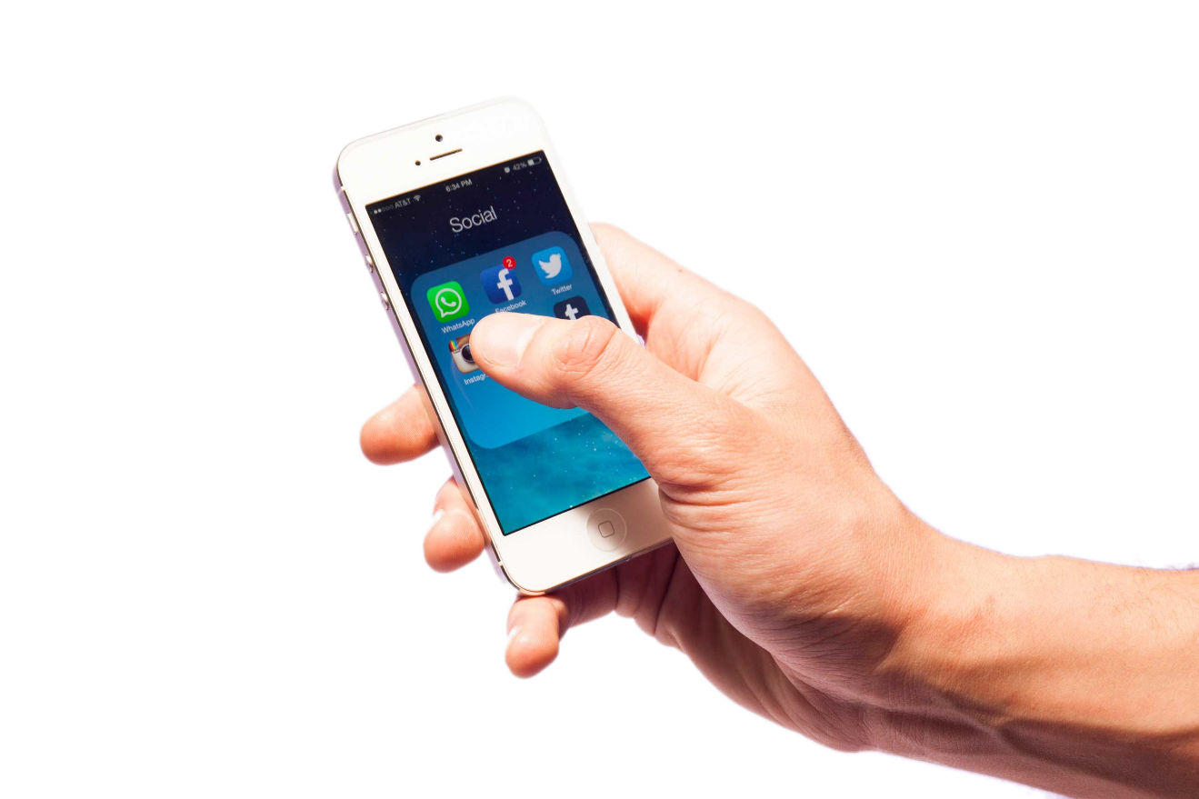
Project planning: Study
Only Right-handed, no movement impaired
Two-handed interaction only
Six conditions
100 target selection per condition
Within-Subject design
~16 participants
Study-length: 15 minutes
source: time.com

Slide 8
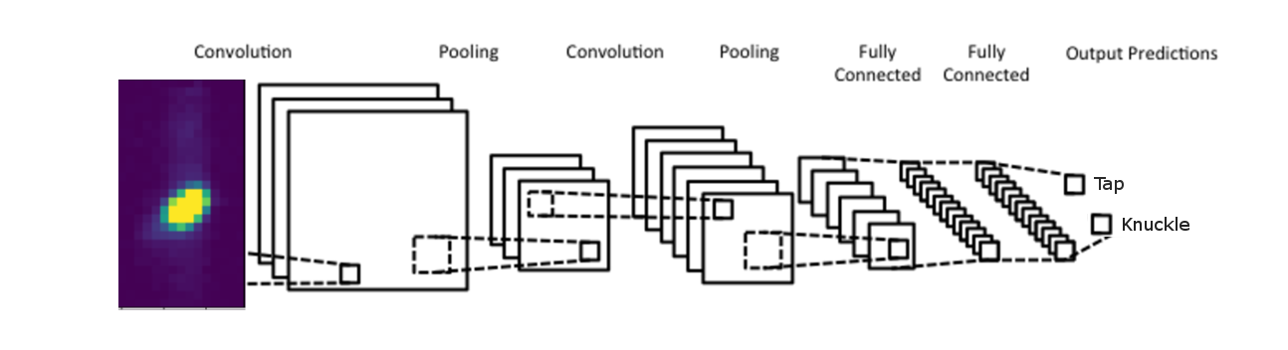
Project planning: Model training
Data: Collected information from user study
One CNN for all data
Binary classifier (Tap vs. Knuckle)

Slide 9
Agenda
Nov
Dec
2019
Feb
2019
2018
Today
11/5/2018
App Development
12/9/2018
Study Conduction
35 days
12/9/2018
12/21/2018
13 days
12/21/2018
Model Training
1/31/2019
1/14/2019
Paper
2/8/2019
42 days
26 days

Slide 10
Questions
CNN or SVM?
Order of input positions randomized or with conditions & Latin-squared
Index or Middlefinger?
Only tapping, or swiping aswell?
One-handed interaction (thump-knuckle)

